Slide 1

Analysis of Algorithms
COMP 272/400C:
Data Structures II
Prof. Silva
These slides were prepared by Prof. Silva adapting the slides from Data Structures & Algorithms in Java (Goodrich et al.) and Data Structures and Algorithm Analysis in Java (Weiss)

Slide 2
Running Time
Most algorithms transform input objects into output objects.
The running time of an algorithm typically grows with the input size.
Average case time is often difficult to determine.
We focus on the worst case running time.
Easier to analyze
Crucial to applications such as games, finance and robotics

Slide 3
Theoretical Analysis
Uses a high-level description of the algorithm instead of an implementation
Characterizes running time as a function of the input size, n.
Takes into account all possible inputs
Allows us to evaluate the speed of an algorithm independent of the hardware/software environment

Slide 4
Pseudocode
Example: find max element of an array
High-level description of an algorithm
More structured than English prose
Less detailed than a program
Preferred notation for describing algorithms
Hides program design issues
Algorithm arrayMax(A, n)
Input array A of n integers
Output maximum element of A
currentMax ← A[0]
for i ← 1 to n − 1 do
if A[i] > currentMax then
currentMax ← A[i]
return currentMax

Slide 5
Math you need to Review
Summations
1 + 2 + …+ n = n(n + 1) / 2
Logarithms and Exponents
Proof techniques
Basic probability
properties of logarithms:
log_{b}(xy) = log_{b}x + log_{b}y
log_{b} (x/y) = log_{b}x - log_{b}y
log_{b}xª = alog_{b}x
log_{b}a = log_{x}a/log_{x}b
properties of exponentials:
a^{(b+c)} = a^{b}a ^{c}
a^{bc} = (a^{b})^{c}
a^{b} /a^{c} = a^{(b-c)}
b = a ^{log}_{a}^{b}
b^{c} = a ^{c*log}_{a}^{b}

Slide 6
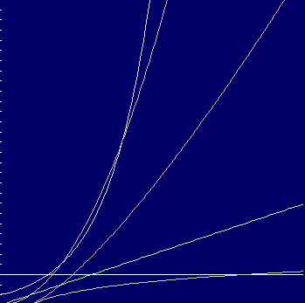
Seven Important Functions
Seven functions that often appear in algorithm analysis:
Constant ≈ 1
Logarithmic ≈ log n
Linear ≈ n
N-Log-N ≈ n log n
Quadratic ≈ n²
Cubic ≈ n³
Exponential ≈ 2^{n}
f(n)=2^{n}
f(n)=n²
f(n)=n log n
f(n)
f(n)=n
f(n)=log n
Graph created with coolmath.com/graphit/
f(n)=c
n

Slide 7
Primitive Operations
Basic computations performed by an algorithm
Identifiable in pseudocode
Largely independent from the programming language
Exact definition not important (we will see why later)
Assumed to take a constant amount of time
Examples:
Evaluating an expression
Assigning a value to a variable
Indexing into an array
Calling a method
Returning from a method

Slide 8
Counting Primitive Operations
By inspecting the pseudocode, we can determine the maximum number of primitive operations executed by an algorithm, as a function of the input size
Algorithm arrayMax(A, n)
# operations
currentMax ← A[0] 2
for (i=1; i<n; i++) 2n
(i=1 once, i<n n times, i++ (n-1) times)
if A[i] > currentMax then 2(n − 1)
currentMax ← A[i] 2(n − 1)
return currentMax 1
Total 6n − 1

Slide 9
Estimating Running Time
Algorithm arrayMax executes 6n − 1 primitive operations in the worst case. Define:
a = Time taken by the fastest primitive operation
b = Time taken by the slowest primitive operation
Let T(n) be worst-case time of arrayMax. Then a (6n − 1) ≤ T(n) ≤ b(6n − 1)
Hence, the running time T(n) is bounded by two linear functions

Slide 10
Growth Rate of Running Time
Changing the hardware/ software environment
Affects T(n) by a constant factor, but
Does not alter the growth rate of T(n)
The linear growth rate of the running time T(n) is an intrinsic property of algorithm arrayMax

Slide 11
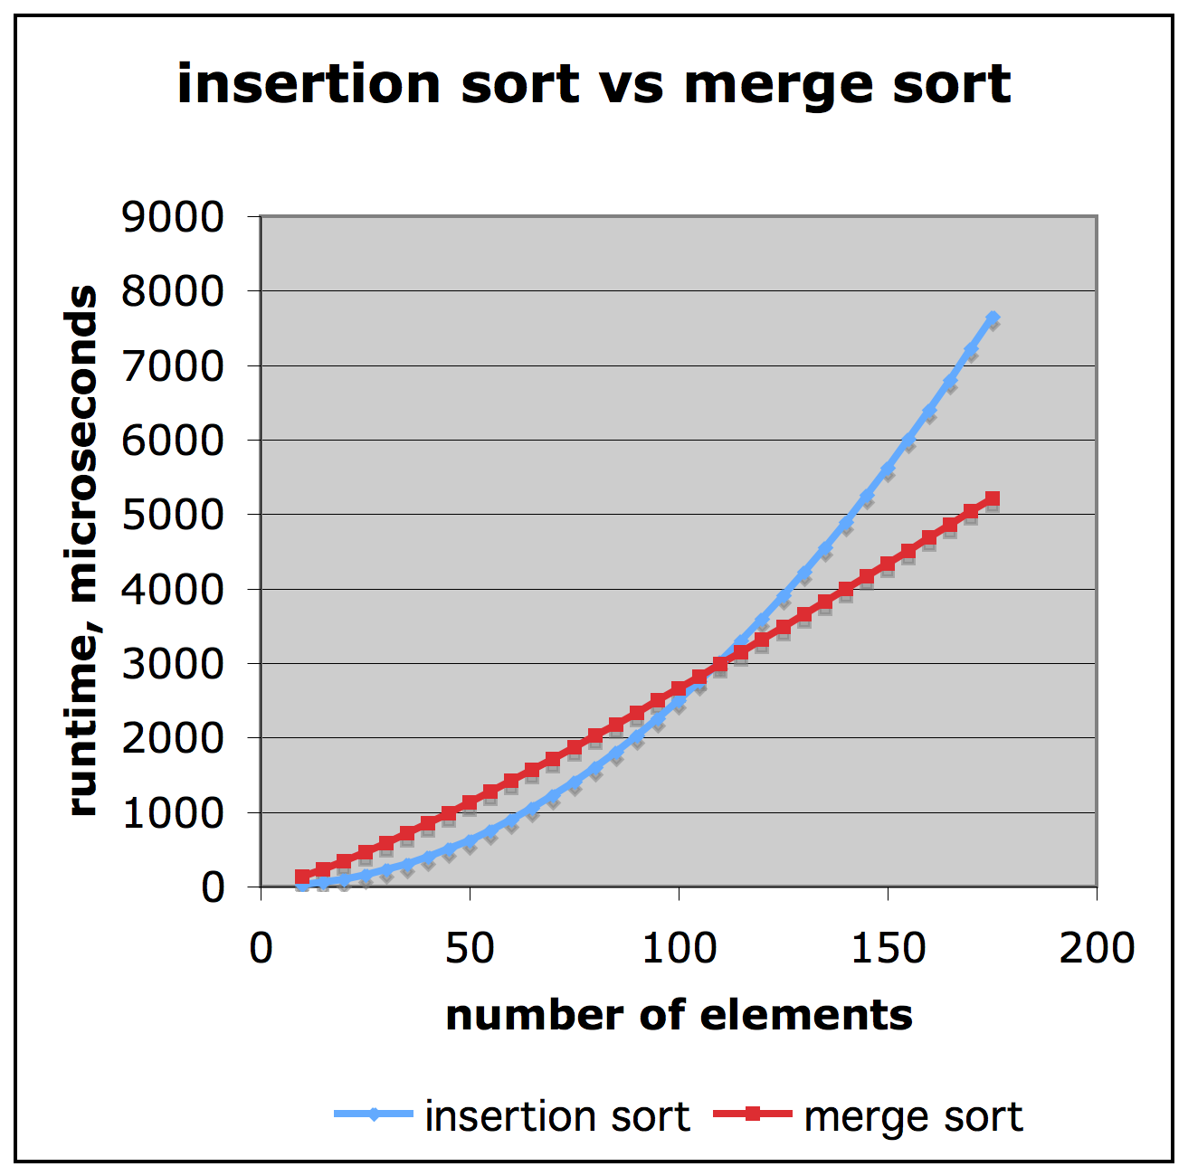
Comparison of Two Algorithms
Slide by Matt Stallmann included with permission.
insertion sort is
n² / 4
merge sort is
2 n lg n
sort a million items?
insertion sort takes
roughly 70 hours
while
merge sort takes
roughly 40 seconds

Slide 12
Constant Factors
The growth rate is not affected by
constant factors or
lower-order terms
Examples
10²n + 10⁵ is a linear function
10⁵n² + 10⁸n is a quadratic function

Slide 13
Big-Oh Notation
Given functions f(n) and g(n), we say that f(n) is O(g(n)) if there are positive constants c and n₀ such that
f(n) ≤ cg(n) for n ≥ n₀
Example: 2n + 10 is O(n)
2n + 10 ≤ 12n, n₀ = 1, c=12

Slide 14
More Big-Oh Examples
7n-2
7n-2 is O(n)
need c > 0 and n₀ ≥ 1 such that 7n-2 ≤ c•n for n ≥ n₀
this is true for c = 7 and n₀ = 1 (7n-2 < 7n, n≥1)
3n³ + 20n² + 5
3n³ + 20n² + 5 is O(n³)
need c > 0 and n₀ ≥ 1 such that 3n³ + 20n² + 5 ≤ c•n³ for n ≥ n₀
this is true for c = 28 and n₀ = 1. (3n³ + 20n² + 5 < 28n³, n≥1)
3 log n + 5
3 log n + 5 is O(log n)
need c > 0 and n₀ ≥ 1 such that 3 log n + 5 ≤ c•log n for n ≥ n₀
this is true for c = 8 and n₀ = 2. (3 log n + 5 < 8 log n, n>1)

Slide 15
Big-Oh and Growth Rate
The big-Oh notation gives an upper bound on the growth rate of a function
The statement “f(n) is O(g(n))” means that the growth rate of f(n) is no more than the growth rate of g(n)

Slide 16
Big-Oh Rules
If f(n) is a polynomial of degree d, then f(n) is O(n^{d}), i.e.,
Drop lower-order terms
Drop constant factors
Use the smallest possible class of functions
Say “2n is O(n)” instead of “2n is O(n²)”
Use the simplest expression of the class
Say “3n + 5 is O(n)” instead of “3n + 5 is O(3n)”

Slide 17
Asymptotic Algorithm Analysis
The asymptotic analysis of an algorithm determines the running time in big-Oh notation
To perform the asymptotic analysis
We find the worst-case number of primitive operations executed as a function of the input size
We express this function with big-Oh notation
Example:
We determine that algorithm arrayMax executes at most 6n − 1 primitive operations
We say that algorithm arrayMax “runs in O(n) time”
Since constant factors and lower-order terms are eventually dropped anyhow, we can disregard them when counting primitive operations

Slide 18
Computing Prefix Averages
We further illustrate asymptotic analysis with two algorithms for prefix averages
The i-th prefix average of an array X is the average of the first (i + 1) elements of X:
A[i] = (X[0] + X[1] + … + X[i])/(i+1)
Computing the array A of prefix averages of another array X has applications to financial analysis

Slide 19
Prefix Averages (Quadratic)
The following algorithm computes prefix averages in quadratic time by applying the definition
Algorithm prefixAverages1(X, n)
Input array X of n integers
Output array A of prefix averages of X #operations
A ← new array of n integers n
for i ← 0 to n − 1 do n
s ← X[0] n
for j ← 1 to i do 1 + 2 + …+ (n − 1)
s ← s + X[j] 1 + 2 + …+ (n − 1)
A[i] ← s / (i + 1) n
return A 1
Algorithm prefixAverages1 runs in O(n²) time

Slide 20
Prefix Averages (Linear)
The following algorithm computes prefix averages in linear time by keeping a running sum
Algorithm prefixAverages2(X, n)
Input array X of n integers
Output array A of prefix averages of X #operations
A ← new array of n integers n
s ← 0 1
for i ← 0 to n − 1 do n
s ← s + X[i] n
A[i] ← s / (i + 1) n
return A 1
Algorithm prefixAverages2 runs in O(n) time

Slide 21
Relatives of Big-Oh
Big-Oh
f(n) is O(g(n)) if f(n) is asymptotically less than or equal to g(n)
big-Omega
f(n) is Ω(g(n)) if f(n) is asymptotically greater than or equal to g(n)
big-Theta
f(n) is Θ(g(n)) if f(n) is asymptotically equal to g(n)

